Slide 1
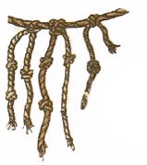
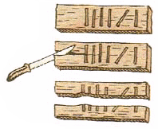
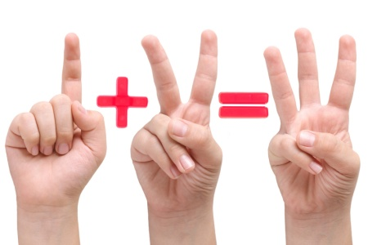

What is a number system?
The number system is the rules for writing numbers using special characters - numbers, as well as the corresponding rules for performing operations with these numbers.
Counting on the fingers:
(Latin unus - one) – one digit denotes one
(1 day, 1 stone ...)
only natural numbers
writing large numbers will be long(1 000 000?)

Slide 2







Egyptian decimal system
line
lotus
– 1
– 10
– 100
– 1000
– 10000
– 100000
– 1000000
clamp
finger
man
rope
frog
= ?
=1235
2014 = ?

Slide 3
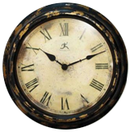
Non-positional number systems
Non-positional number systems: the value of the digit does not depend on its place in the number record.
Unary
Egyptian decimal
roman

Slide 4
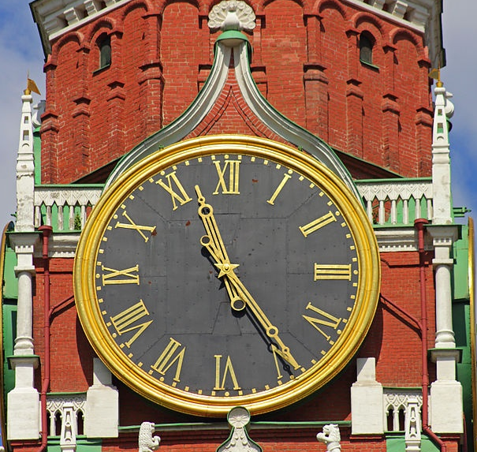
Roman number system
I – 1 (finger),
V – 5 (open palm, 5 fingers),
X – 10 (two palms),
L – 50,
C – 100 (Centum),
D – 500 (Demimille),
M – 1000 (Mille)

Slide 5
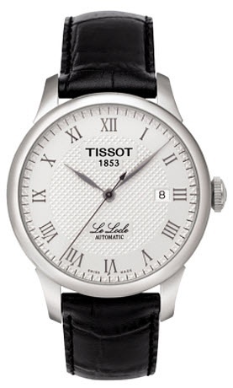
Roman number system
Rules :
(usually do not put more than three identical numbers in a row)
if the least significant digit (only one!) is to the left of the most significant one, it is subtracted from the sum)
Examples:
MDCXLIV =
1000
+ 500
+ 100
– 10
+ 50
– 1
+ 5
= 1644
2389 = 2000 + 300 + 80 + 9
M M
CCC
LXXX
IX
2389 = M M C C C L X X X I X

Slide 6
Roman number system
only natural numbers(fractional?
negative?)
to write large numbers, you need to enter new numbers
difficult to perform calculations
?
What is the maximum number you can write?

Slide 7
Positional system : the value of a digit is determined by its position in the number record.
The alphabet of the number system is the set of numbers used in it.
The base of the number system is the number of digits in the alphabet (the power of the alphabet)..
Digits in the notation of integers are numbered from zero from right to left.

Slide 8
expanded form of writing a number
hundreds tens units
Thousand
3 2 1 0
positions
6 3 7 5
= 6·10³ + 3·10² + 7·10¹ + 5·10⁰
6000
300
70
5
Horner's scheme
6 3 7 5 = ((6⋅10 + 3)⋅10 + 7)⋅10 + 5

Slide 9
Decimal conversion
=1
positions: 3 2 1 0
1234₅ = 1⋅5³ + 2⋅5² + 3⋅5¹ + 4⋅5⁰ = 194
radix (base)
positions: 3 2 1 0
a₃a₂a₁a₀ = a₃⋅p ³ + a₂⋅p ² + a₁⋅p ¹ + a₀⋅p ⁰
Horner's scheme:
1234₅ = ((1⋅5 + 2)⋅5 + 3)⋅5 + 4 = 194
a₃a₂a₁a₀ = ((a₃⋅p + a₂)⋅p + a₁)⋅p + a₀

Slide 10
Conversion from decimal system to any number system
10 → 5
194
5
190
194 = 1234₅
38
5
4
35
7
5
3
5
1
5
2
0
0
1
We divide the number by p, discarding the remainder at each step, until we get 0.

Slide 11
Tasks
Task: In a certain number system, the number 71 is written as «56_{x}». Determine the radix X.
71 = 56_{X}
there is a 6 in the number, so X > 6
convert the right side to the decimal system
we solve the equation
1 0
56_{x}
= 5·X¹ + 6·X⁰
= 5·X + 6
71 = 5·X + 6
X = 13

Slide 12
Tasks
Task: In a certain number system, the number 71 is written as "155x“. Determine the radix X.
71 = 155_{X}
there is a 5 in the number, so X > 5
convert the right side to the decimal system
we solve the equation
2 1 0
155_{x}
= 1·X² + 5·X¹ + 5·X⁰
= X² + 5·X + 5
71 = X² + 5·X + 5
X = 6
X = -11

Slide 13
Tasks
Task: Find all bases of number systems in which the decimal number 24 ends in the digit 3
in the number 3..
24 = k·X + 3
X = 3, 7, 21
21 = k·X

Slide 14
Tasks
Task:
find all decimal numbers not exceeding 40 and ending in 11 in base 4
N = k·4² + 1·4 + 1 = k·16 + 5
При k =0, 1, 2, 3, … получаем
N = 5, 21, 37, 53, …

Slide 15
Tasks
Task: All 5-letter words composed of the letters A, O and U are written in alphabetical order. Here is the top of the list :
1. ААААА
2. ААААО
3. ААААU
4. АААОА
5. …
Find the word that is 140th from the beginning of the list..
А → 0
1. 00000
2. 00001
3. 00002
4. 00010
5. …
in the ternary system!
O → 1
U → 2
at the first place : 0
at 140th place : 139
139 = 12011₃
ОUАОО

Slide 16
Fractional numbers
0,6375 = 6·0,1 + 3·0,01 + 7·0,001 + 5·0,0001
positions: -1 -2 -3 -4
0, 6 3 7 5 = 6·10⁻¹ + 3·10⁻² + 7·10⁻³ + 5·10⁻⁴
0, 1 2 3 4₅ = 1·5⁻¹ + 2·5⁻² + 3·5⁻³ + 4·5⁻⁴
decimal conversion
Horner's scheme:
0, 6375 = 10⁻¹·(6 + 10⁻¹·(3 + 10⁻¹·(7 + 10⁻¹·5)))
0,1234₅ = 5⁻¹·(1 + 5⁻¹·(2 + 5⁻¹·(3 + 5⁻¹·4)))
decimal conversion

Slide 17
0,1234₅ = 5⁻¹·(1 + 5⁻¹·(2 + 5⁻¹·(3 + 5⁻¹·4)))
5·(0,1234₅)= 1 + 5⁻¹·(2 + 5⁻¹·(3 + 5⁻¹·4))
whole part
fractional part
0,a₁a₂a₃a₄ = p⁻¹⋅(a₁ + p⁻¹⋅(a₂ + p⁻¹⋅(a₁ + p⁻¹⋅ a₀)))
p⋅(0,a₁a₂a₃a₄) = a₁ + p⁻¹⋅(a₂ + p⁻¹⋅(a₁ + p⁻¹⋅ a₀))

Slide 18
Fractional numbers: from decimal to any number system
0,9376
10 → 5
Calculations | Whole part | Fractional part
0,9376 ⋅ 5 = 4,688 | 4 | 0,688
0,688 ⋅ 5 = 3,44 | 3 | 0,44
0,44 ⋅ 5 = 2,2 | 2 | 0,2
0,2 ⋅ 5 = 1 | 1 | 0
0,9376 = 0,4321₅
10 → 5
0,3
?

Slide 19
10 → 6
25,375
= 25 + 0,375

Slide 20
Decimal | Binary | Hexadecimal | Octal
0 | 00000 | 0 | 0
1 | 0001 | 1 | 1
2 | 0010 | 2 | 2
3 | 0011 | 3 | 3
4 | 0100 | 4 | 4
5 | 0101 | 5 | 5
6 | 0110 | 6 | 6
7 | 0111 | 7 | 7
8 | 1000 | 8 | 10
9 | 1001 | 9 | 11
10 | 1010 | A | 12
11 | 1011 | B | 13
12 | 1100 | C | 14
13 | 1101 | D | 15
14 | 1110 | E | 16
15 | 1111 | F | 17

Slide 21
Binary Number System

Slide 22
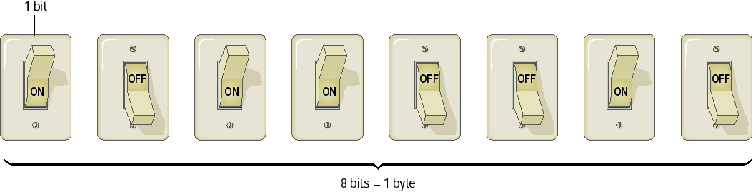
Binary numbers are represented by sequence of bits (smallest unit of information – 0 or 1)
Bits are easy to represent in electronics

Slide 23
Binary Number System
Base (radix): 2
Alphabet: 0, 1
10 → 2
19
2
18
19 = 10011₂
9
2
1
8
4
2
1
4
2
2
0
2
1
2
0
0
0
2 → 10
1
4 3 2 1 0
positions
10011₂
= 1·2⁴ + 0·2³ + 0·2² + 1·2¹ + 1·2⁰
= 16 + 2 + 1 = 19

Slide 24
Binary to Decimal Conversion
positions
6 5 4 3 2 1 0
1001101₂ = 2⁶ + 2³ + 2² + 2⁰
= 64 + 8 + 4 + 1 = 77
Position |  | Calculations | Result
6 | 1 | 1 | 1
5 | 0 | 1⋅2+0 | 2
4 | 0 | 2⋅2+0 | 4
3 | 1 | 4⋅2+1 | 9
2 | 1 | 9⋅2+1 | 19
1 | 0 | 19⋅2+0 | 38
0 | 1 | 38⋅2+1 | 77

Slide 25
Fractional numbers
10 → 2
0,8125
Calculations | Whole part | Fractional part
0,8125 ⋅ 2 = 1,625 | 1 | 0,625
0,625 ⋅ 2 = 1,25 | 1 | 0,25
0,25 ⋅ 2 = 0,5 | 0 | 0,5
0,5 ⋅ 2 = 1 | 1 | 0
0,8125 = 0,1101₂
10 → 2
0,6 =
0,100110011001… =
0,(1001)₂
!
Infinite number of digits

Slide 26
Octal number system
Radix: 8
Alphabet: 0, 1, 2, 3, 4, 5, 6, 7
10 → 8
100
8
96
12
8
4
8
1
8
100 = 144₈
4
0
0
1
8 → 10
2 1 0
positions
144₈
= 1·8² + 4·8¹ + 4·8⁰
= 64 + 32 + 4 = 100
26

Slide 27
Tasks
134 =
75 =
134₈ =
75₈ =

Slide 28
Octal number system
X₁₀ | X₈ | X₂
0 | 0 | 000
1 | 1 | 001
2 | 2 | 010
3 | 3 | 011
4 | 4 | 100
5 | 5 | 101
6 | 6 | 110
7 | 7 | 111

Slide 29
Octal to binary
10
laborious
2 operations
8
2
8 = 2³
!
Each octal digit can be written as three binary (triad)
1725₈ =
001
111
010
101₂
{
{
{
{
1 7 2 5

Slide 30
3467₈ =
2148₈ =
7352₈ =
1231₈ =

Slide 31
Binary to octal
1001011101111₂
Step 1 − Divide the binary digits into groups of three (starting from the right).:
001 001 011 101 111₂
Step 2 − Convert each group of three binary digits to one octal digit.
001 001 011 101 111₂
1
1
3
5
7
Answer: 1001011101111₂ = 11357₈

Slide 32
101101010010₂ =
11111101011₂ =
1101011010₂ =

Slide 33
Hexadecimal number system

Slide 34
Hexadecimal number system
Base: 16
Alphabet: 0, 1, 2, 3, 4, 5, 6, 7, 8, 9,
A, 10
B, 11
C, 12
D, 13
E, 14
F 15
10 → 16
444
16
432
444 = 1BC₁₆
27
16
12
16
1
16
С
11
0
B
0
1
16 → 10
2 1 0
positions
1BC₁₆
B
C
= 1·16² + 11·16¹ + 12·16⁰
= 256 + 176 + 12 = 444

Slide 35
Примеры
171 =
1C5₁₆ =
206 =
22B₁₆ =

Slide 36
Hexadecimal number system
X₁₀ | X₁₆ | X₂ |  | X₁₀ | X₁₆ | X₂
0 | 0 | 0000 |  | 8 | 8 | 1000
1 | 1 | 0001 |  | 9 | 9 | 1001
2 | 2 | 0010 |  | 10 | A | 1010
3 | 3 | 0011 |  | 11 | B | 1011
4 | 4 | 0100 |  | 12 | C | 1100
5 | 5 | 0101 |  | 13 | D | 1101
6 | 6 | 0110 |  | 14 | E | 1110
7 | 7 | 0111 |  | 15 | F | 1111

Slide 37
Hexadecimal to Binary
10
16
2
16 = 2⁴
!
Convert each hexadecimal digit to a 4-digit binary number
7F1A₁₆ =
0111
1111
0001
1010₂
{
{
{
{
7 F 1 A

Slide 38
C73B₁₆ =
2FE1₁₆ =

Slide 39
Binary to Hexadecimal
1001011101111₂
Step 1- Divide the binary digits into groups of four (starting from the right).:
0001 0010 1110 1111₂
Step 2 − Convert each group of four binary digits to one hexadecimal symbol.
0001 0010 1110 1111₂
1
2
E
F
Answer: 1001011101111₂ = 12EF₁₆

Slide 40
1010101101010110₂ =
111100110111110101₂ =
110110110101111110₂ =

Slide 41
Hexadecimal to octal and back
10
laborious
16
8
2
Step 1. Convert to binary
3DEA₁₆ =
11 1101 1110 1010₂
Step 2. Break into triads (right)::
011 110 111 101 010₂
Step 3. Triad is one octal digit
3DEA₁₆ = 36752₈

Slide 42
A35₁₆ =
765₈ =

